Slide 1
EXPERIMENT 3
Configuration of Topologies using Packet Tracer ( Bus, Ring, Hybrid)
ALGORITHM:
Step 1: First, open the cisco packet tracer desktop and select the devices
Use an Automatic connecting cable to connect the devices with others.
Step 2: Configure the PCs (hosts) with IPv4 address and Subnet Mask according to the IP addressing table given above.
To assign an IP address in PC0, click on PC0.
Then, go to desktop and IP configuration and there you will find IPv4 configuration.
Add IPv4 address and subnet mask.
Step 3: Verify the connection by pinging the IP address of any host in PC0.
Use the ping command to verify the connection.
We will check, if we are getting any replies or not.
As we can see here getting replies from a targeted node on both PCs. Hence the connection is verified.
A simulation of the experiment is given below we have sent two PDU packets one targeted from PC0 to PC4 and another targeted from PC3 to PC8

Slide 2
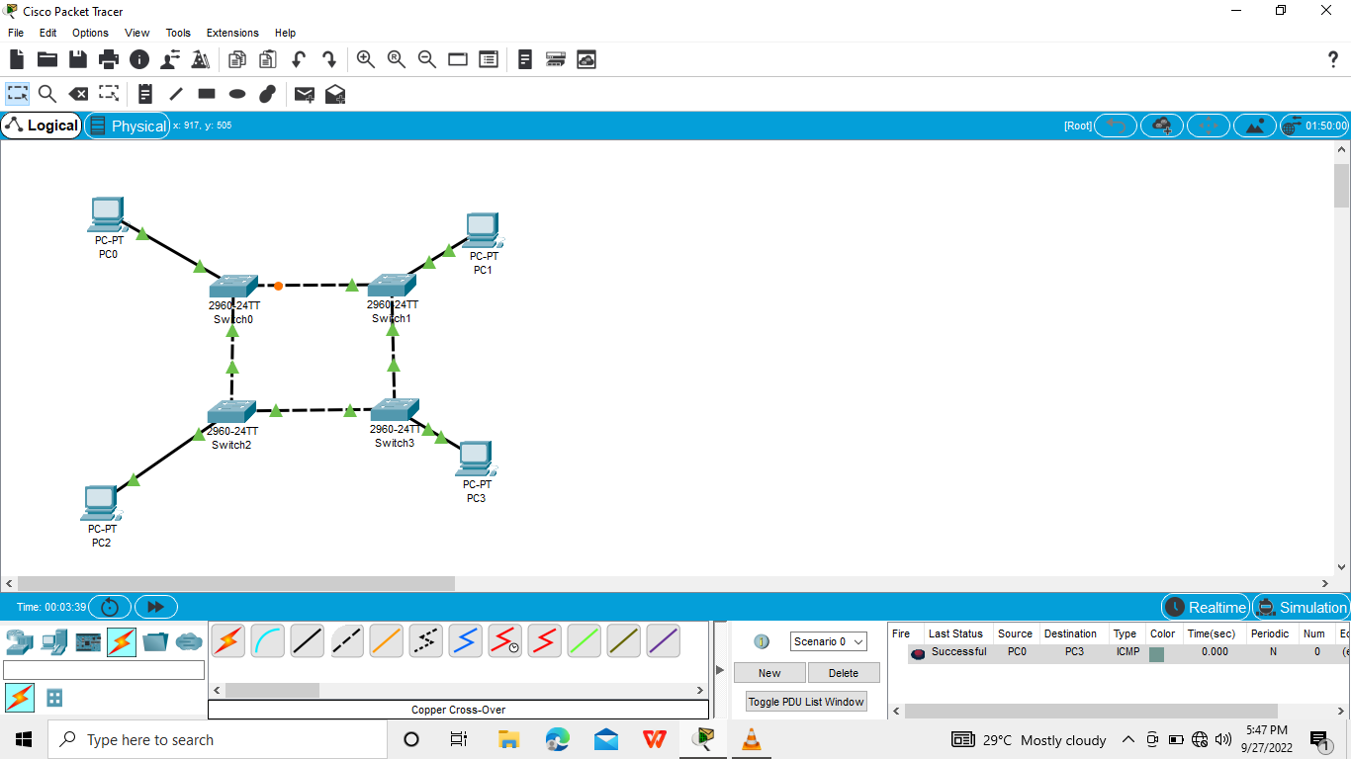
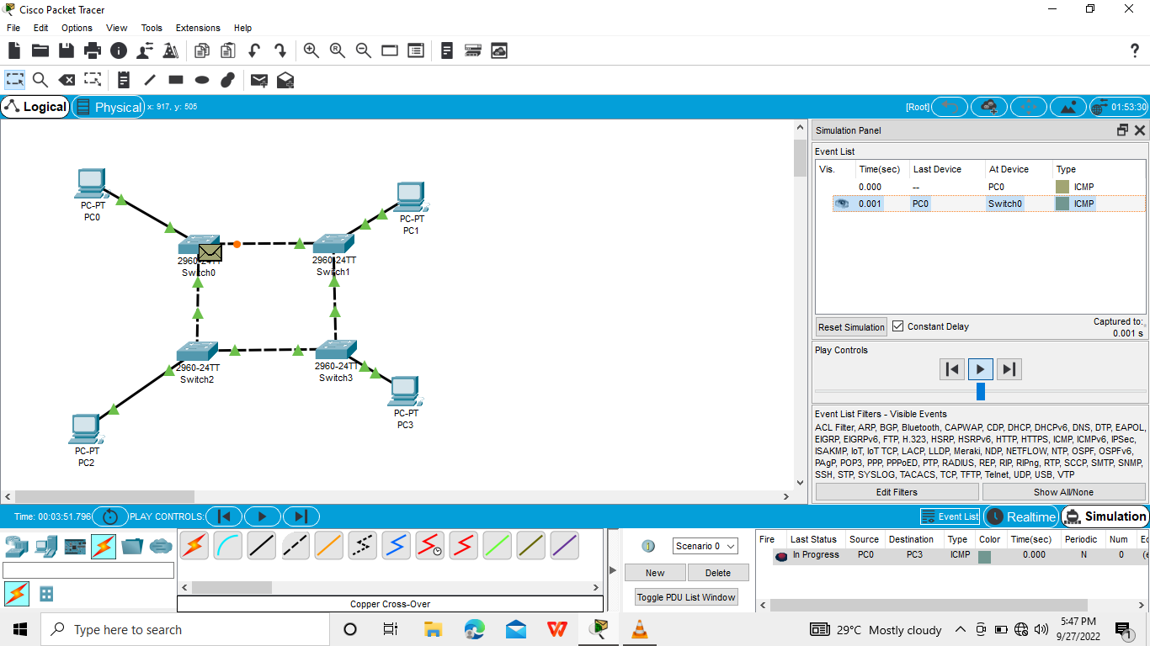

Slide 3
